Slide 1
Chapter 13

Slide 2
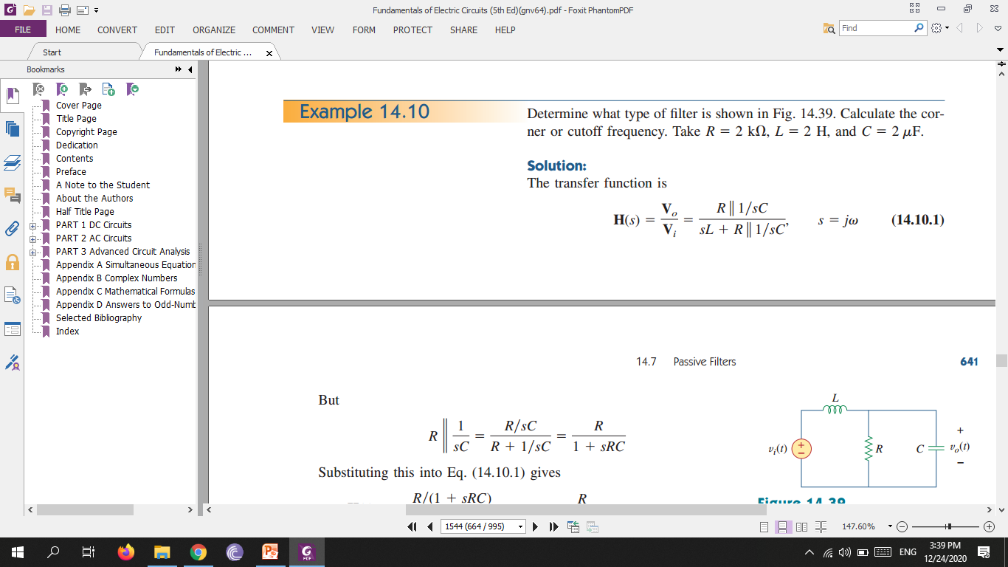
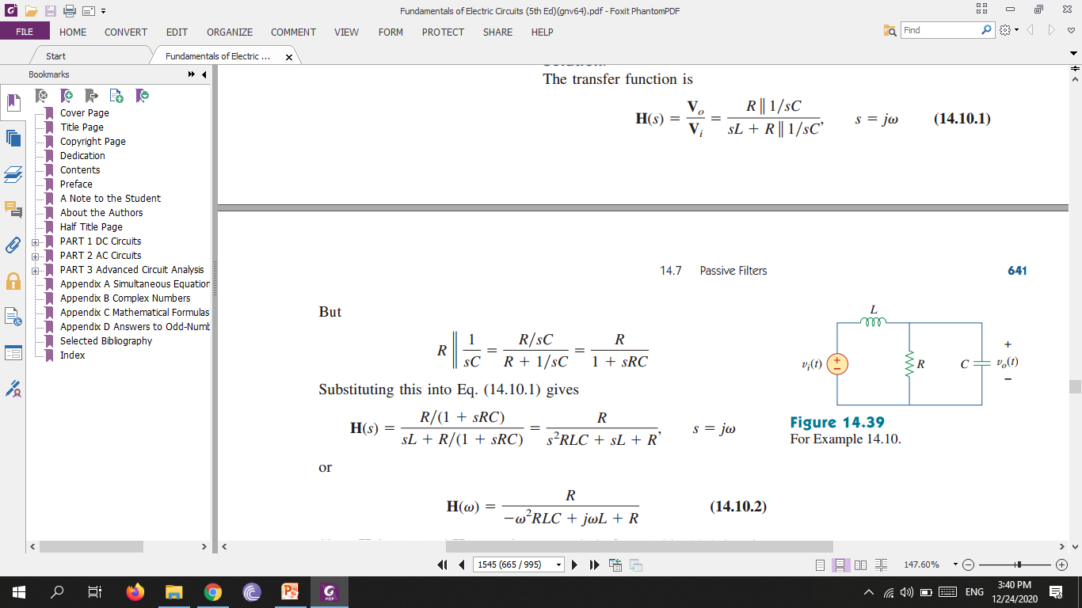
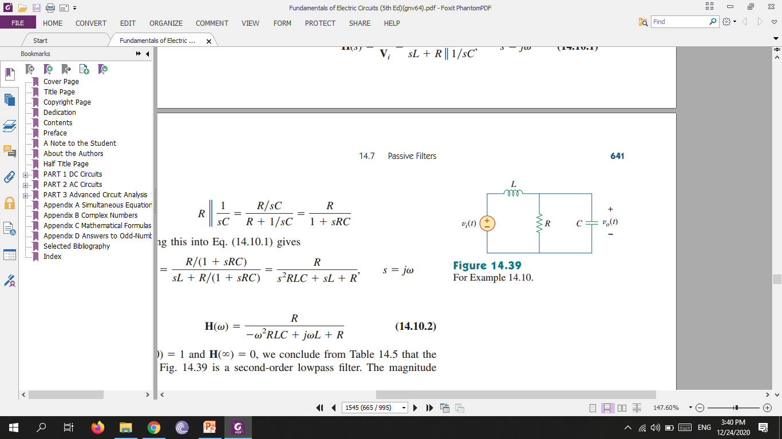
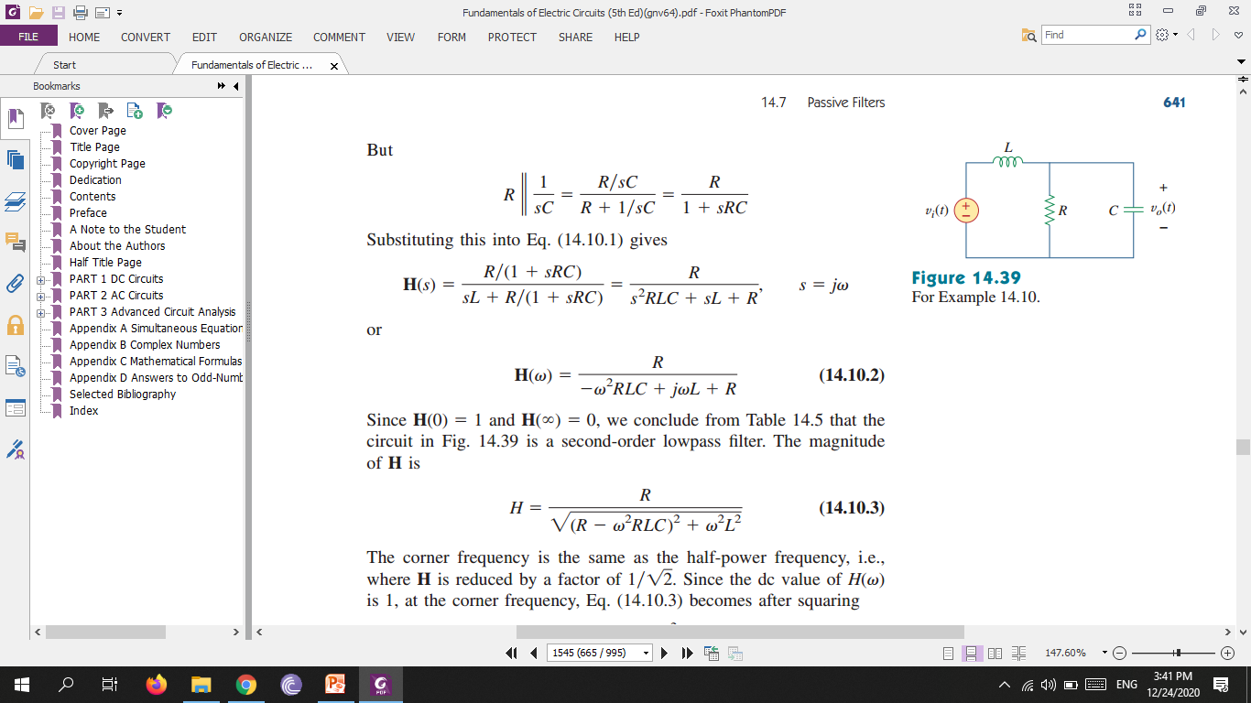

Slide 3
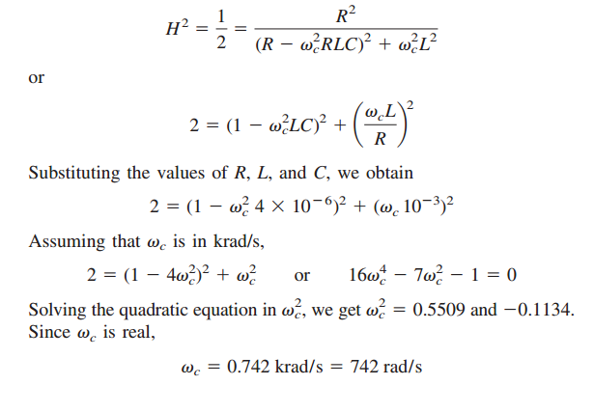

Slide 4
Mutual Inductance
When two inductors (or coils) are in a close proximity to each other, the magnetic flux caused by current in one coil links with the other coil, thereby inducing voltage in the latter. This phenomenon is known as mutual inductance.

Slide 5
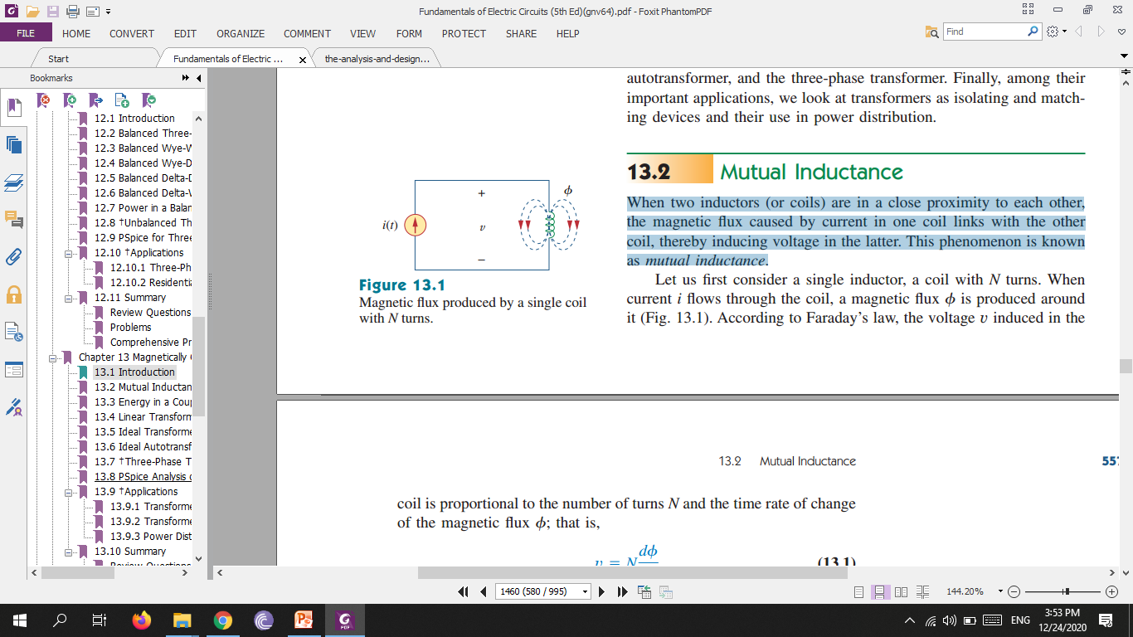
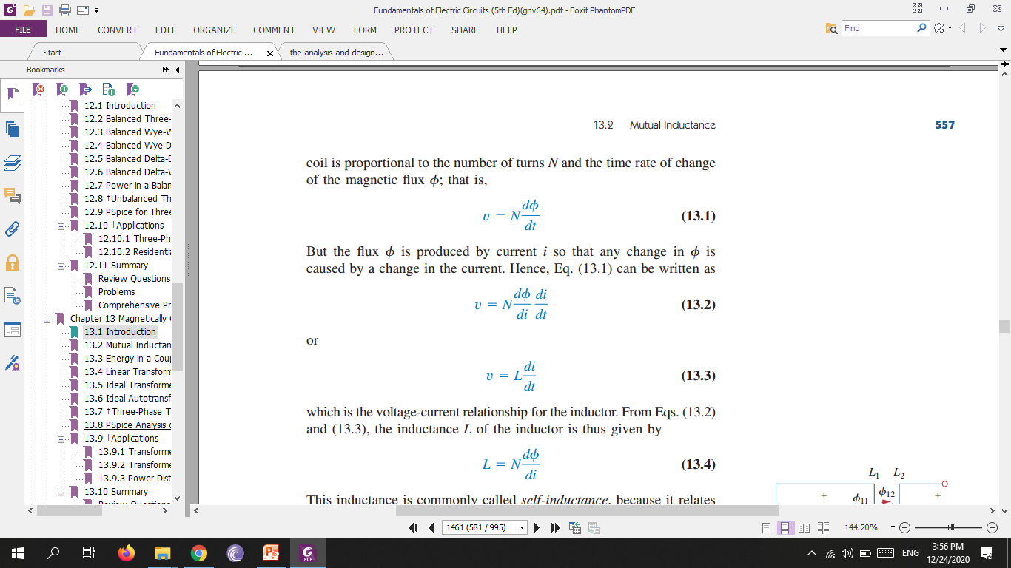
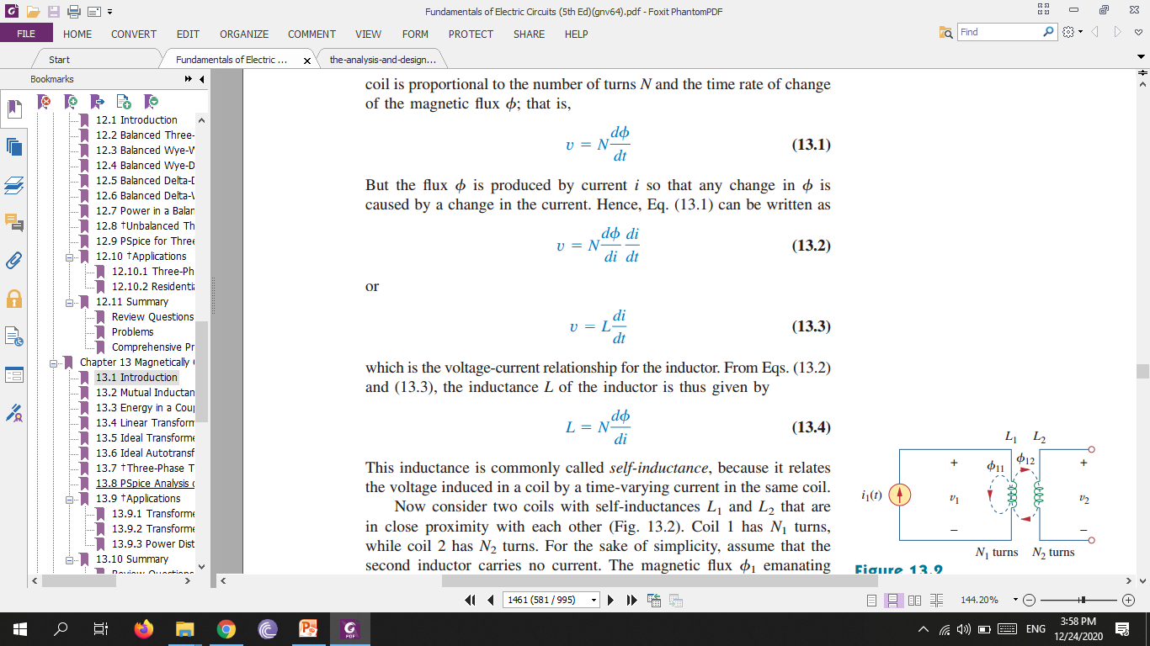
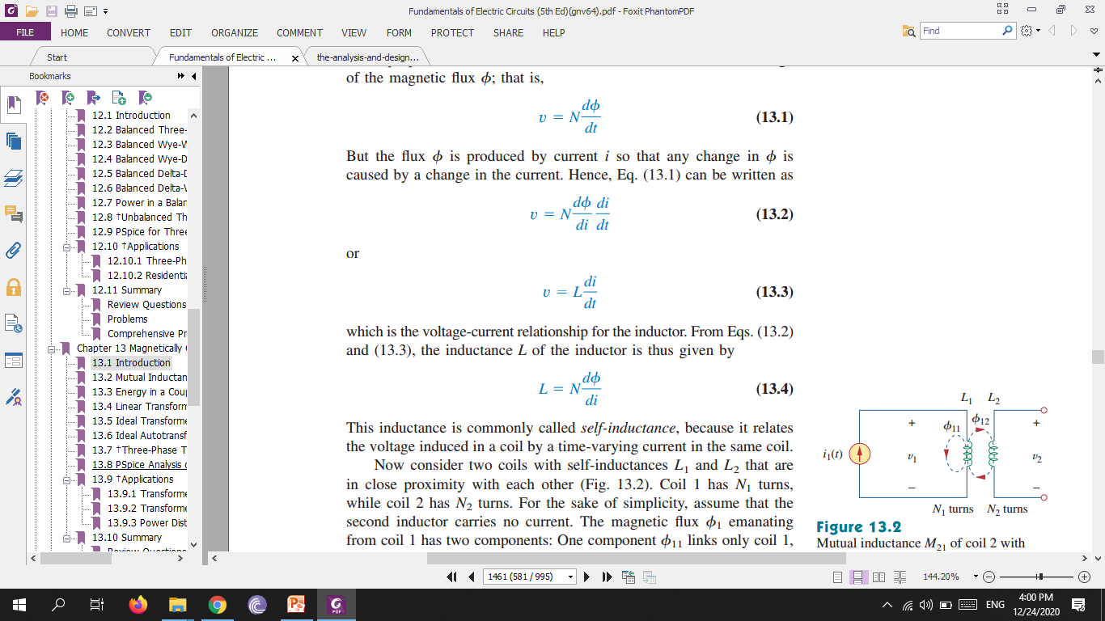
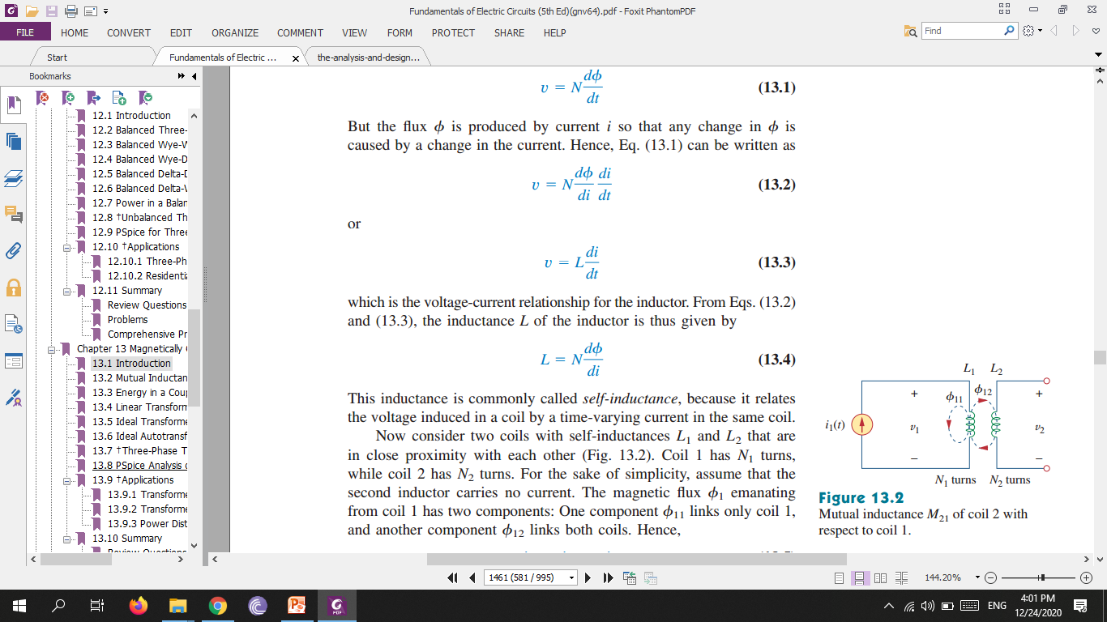
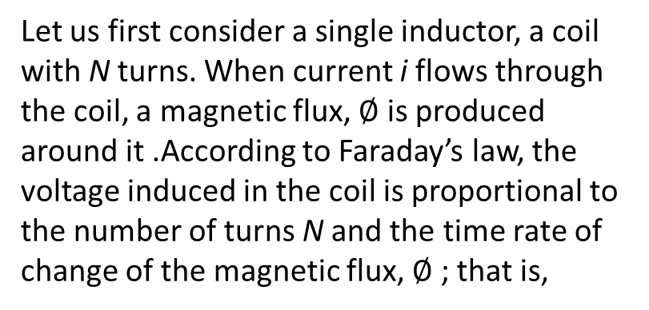
Let us first consider a single inductor, a coil with N turns. When current i flows through the coil, a magnetic flux, $∅$ is produced around it .According to Faraday’s law, the voltage induced in the coil is proportional to the number of turns N and the time rate of change of the magnetic flux, $∅$ ; that is,
But the flux $∅$ is produced by current i so that any change in is caused by a change in the current. Hence, above equation can be written as
But
So
This inductance is commonly called self-inductance, because it relates the voltage induced in a coil by a time-varying current in the same coil.

Slide 6
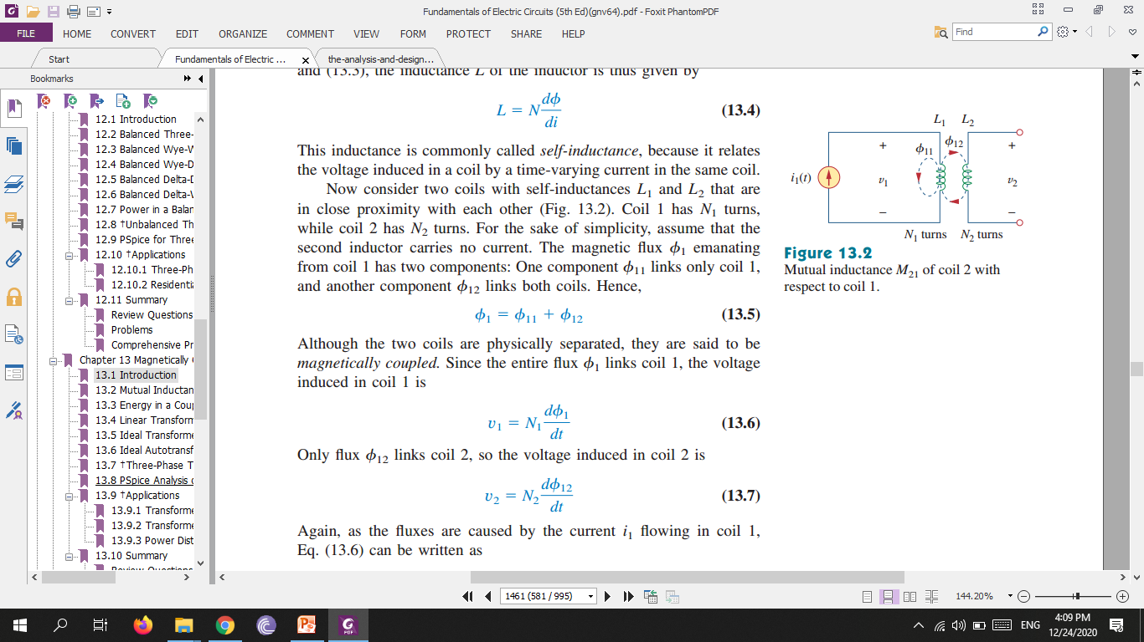
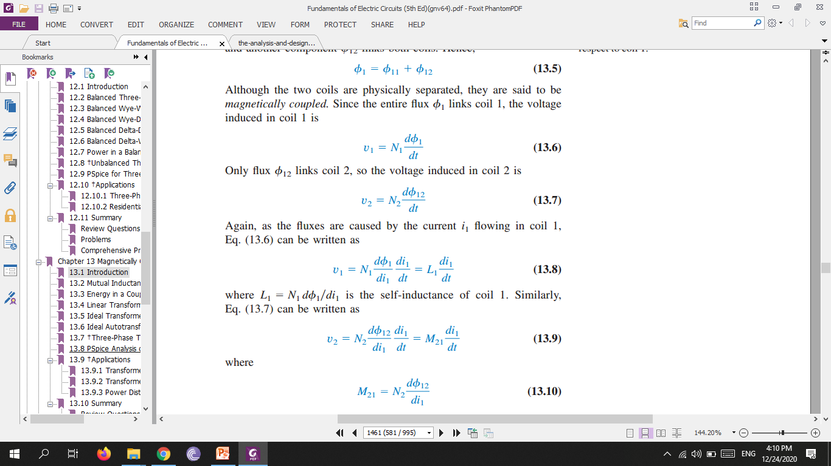

Slide 7
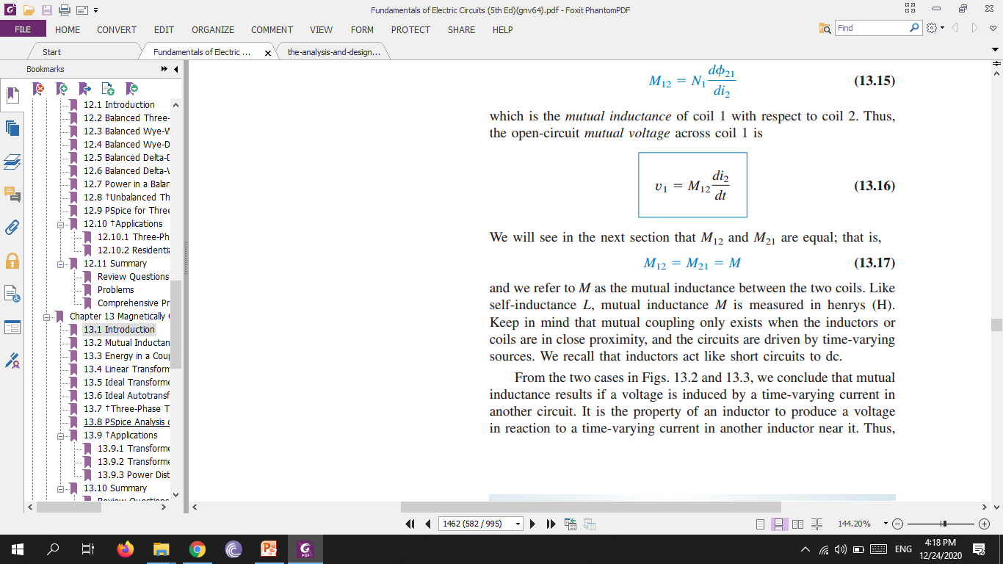
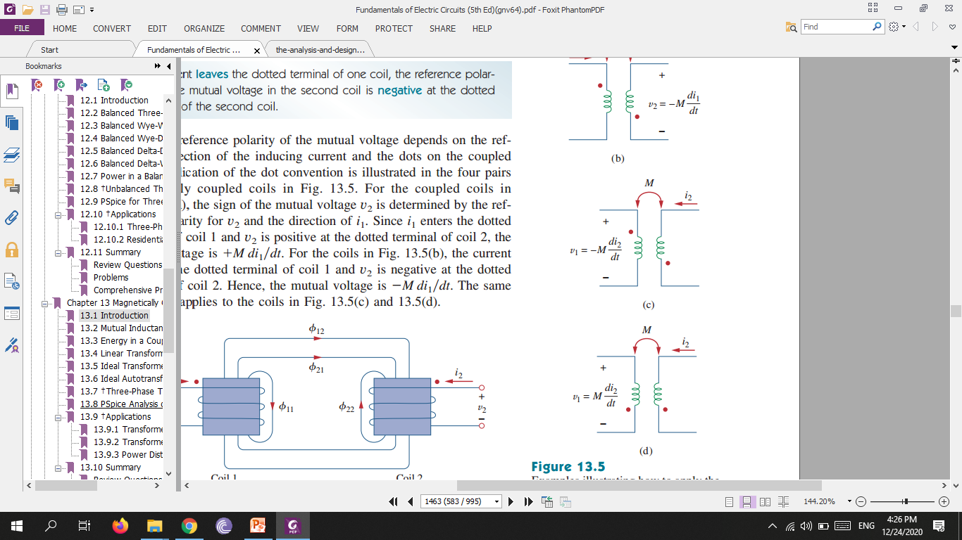
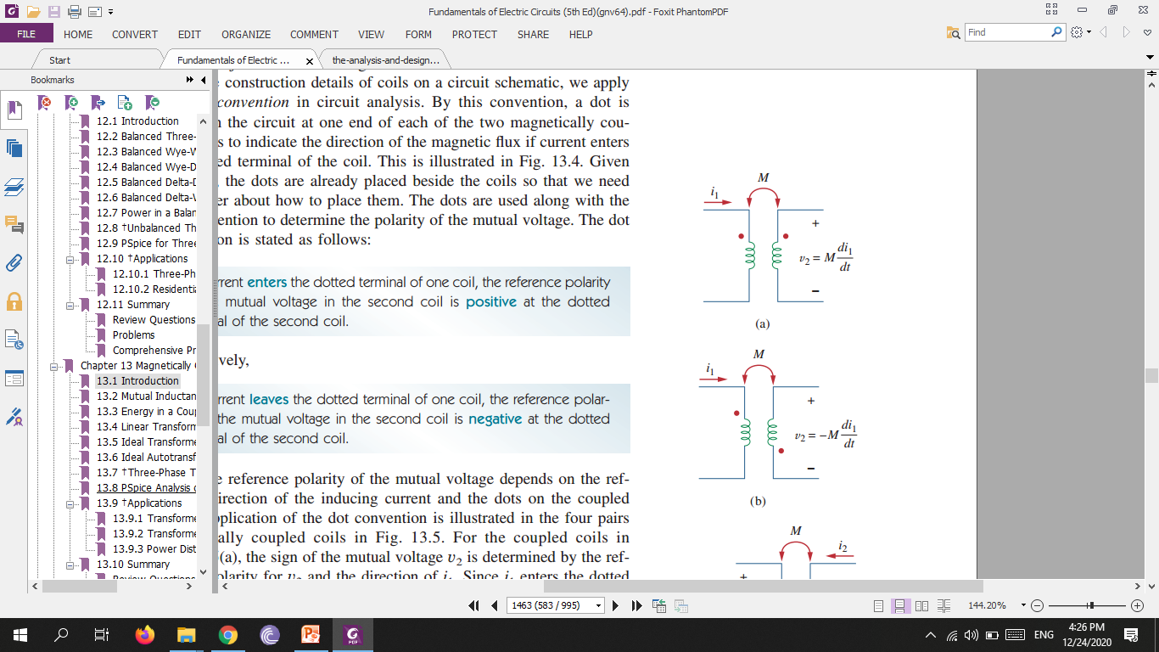
we refer to M as the mutual inductance between the two coils. Like self-inductance L, mutual inductance M is measured in henrys (H). Keep in mind that mutual coupling only exists when the inductors or coils are in close proximity, and the circuits are driven by time-varying sources. We recall that inductors act like short circuits to dc.
Mutual inductance is the ability of one inductor to induce a voltage across a neighboring inductor, measured in henrys (H).

Slide 8
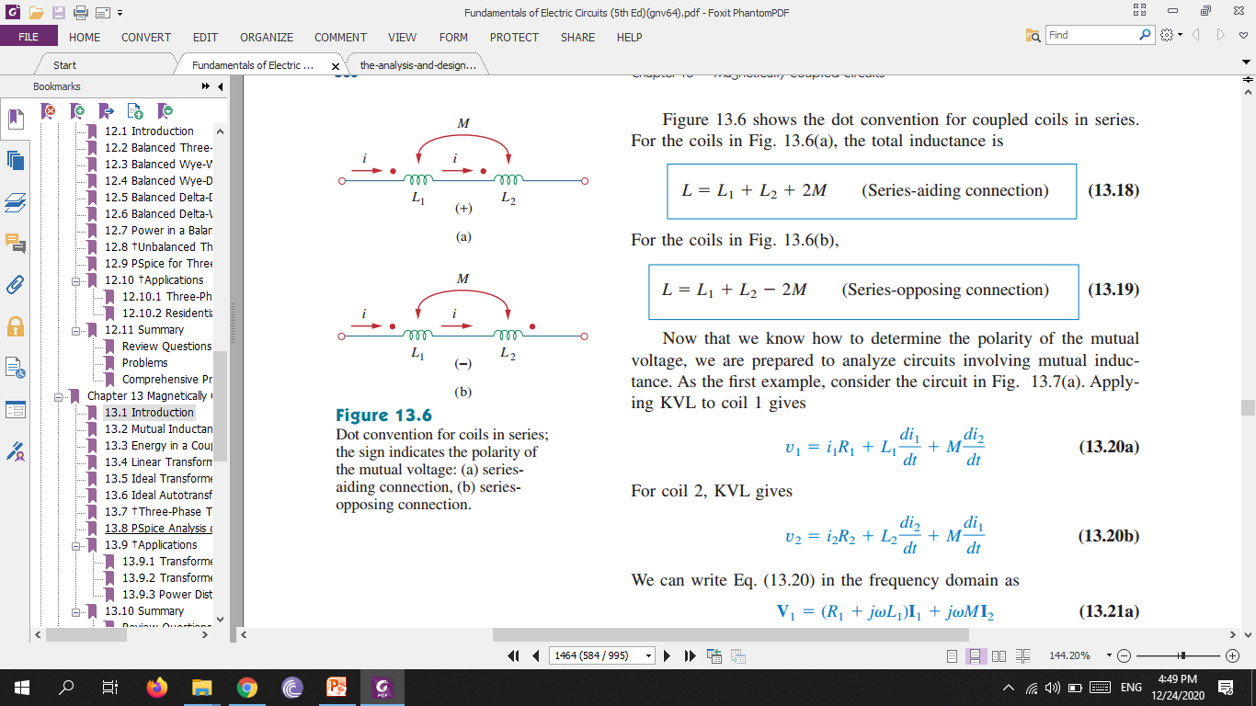
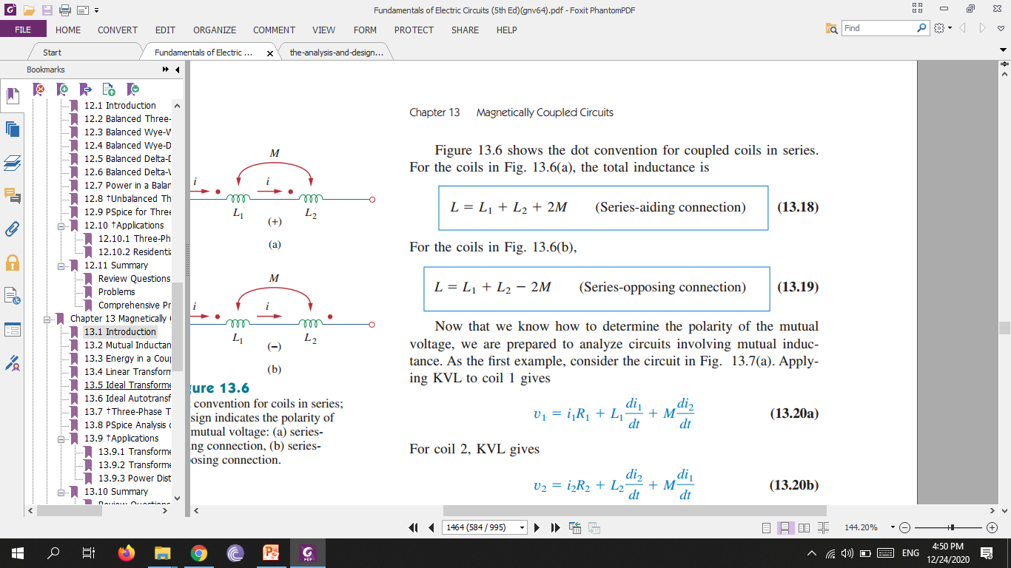
If a current enters the dotted terminal of one coil, the reference polarity of the mutual voltage in the second coil is positive at the dotted terminal of the second coil. Alternatively,
If a current leaves the dotted terminal of one coil, the reference polarity of the mutual voltage in the second coil is negative at the dotted terminal of the second coil.

Slide 9
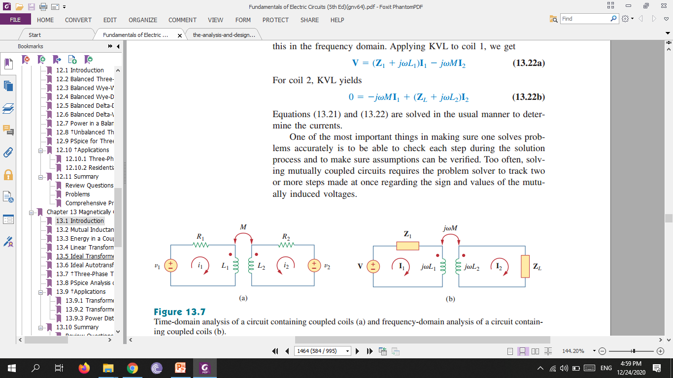
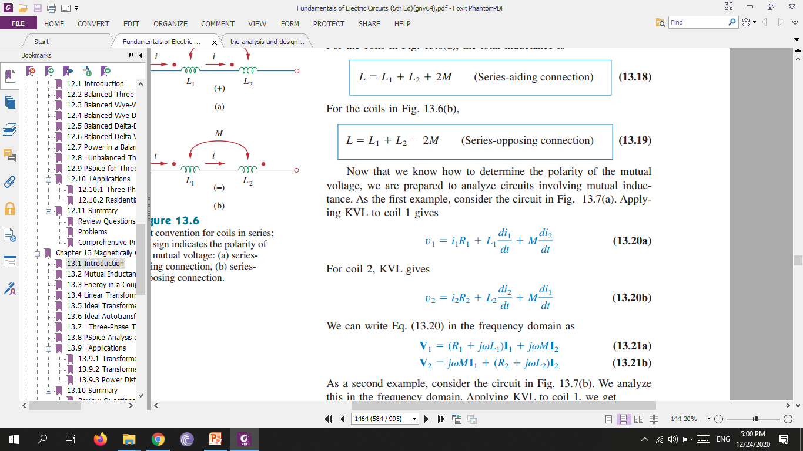

Slide 10
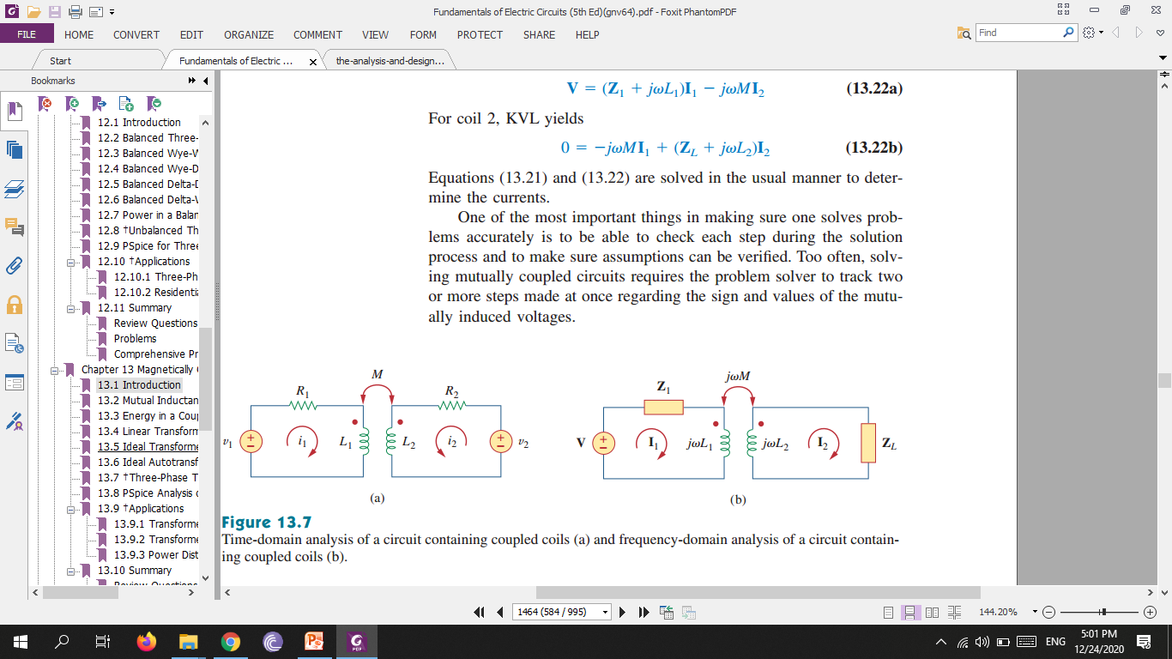
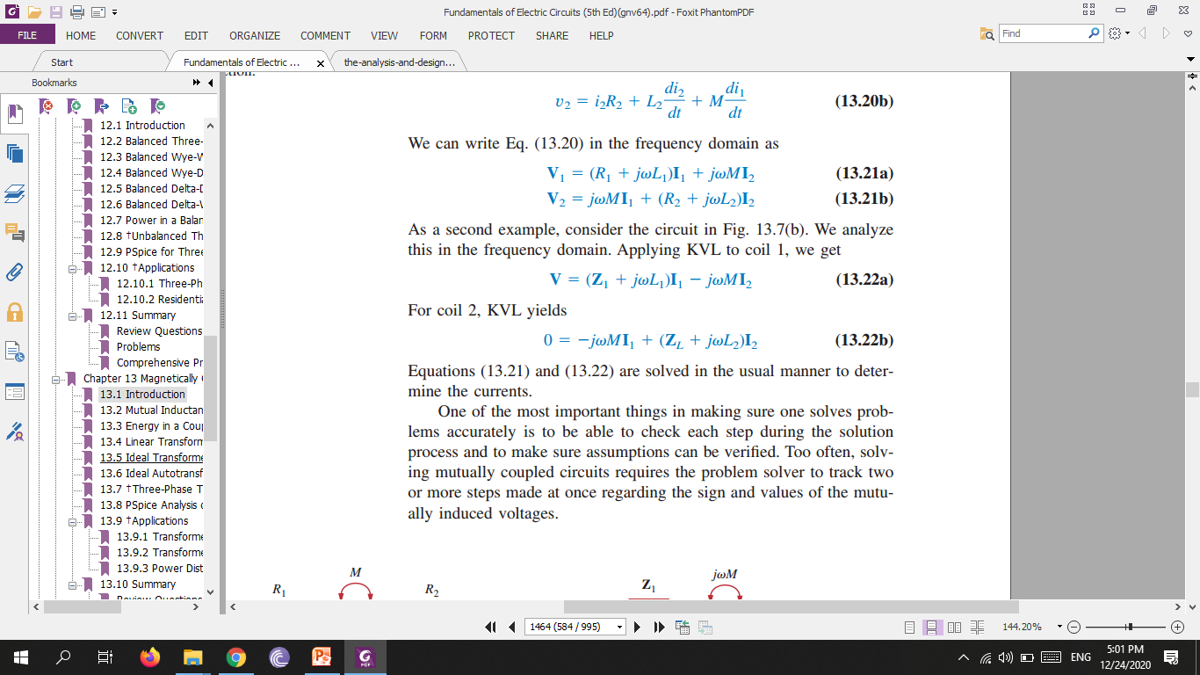

Slide 11
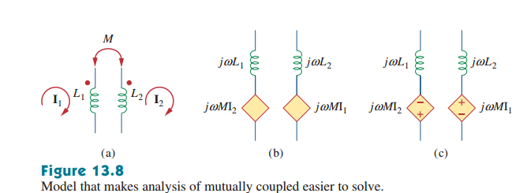

Slide 12
